Slide 1
Cognitive load in science and introducing integrated instructions
Objectives
List and combine the central components of cognitive load
Identify and examine exemplar strategies to maxinimse the chance of new knowledge entering the long term memory.
CCF LINK Section 2 How pupils learn. Learn that:
Working memory is where information that is being actively processed is held, but its capacity is limited and can be overloaded.
Long-term memory can be considered as a store of knowledge that changes as pupils learn by integrating new ideas with existing knowledge.
Worked examples that take pupils through each step of a new process are also likely to support pupils to learn.
Learn how to
Discussing and analysing with expert colleagues how to reduce distractions that take attention away from what is being taught (e.g. keeping the complexity of a task to a minimum, so that attention is focused on the content). And - following expert input - by taking opportunities to practise, receive feedback and improve at:
Breaking complex material into smaller steps (e.g. using partially completed examples to focus pupils on the specific steps).

Slide 2



Acknowledgements
RSC Chemical Education Research Group Teacher-Researcher Fellowship Scheme 2018
David Patterson under the supervison of Suzanne Fergus, Michael Seery.
Staff and students at Aldenham School
Steve Jones and Bob Worley, CLEAPSS

Slide 3
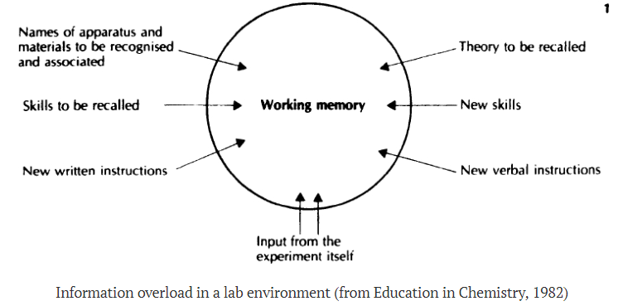
Practical work – a hard ask for students
Clark, R., Nguyen, F. & Sweller, J. (2006) Efficiency in Learning: Evidence-Based Guidelines to Manage Cognitive Load. John Wiley & Sons.

Slide 4
Working and Long Term Memory
Rehearsal
Sensory
information
Sensory
Memory
Working
Memory
Encoding
Long Term
Memory
Attention
Retrieval
Forgetting
Forgetting
Forgetting
Atkinson–Shiffrin memory model (1968) / Baddeley (1992) for WM rather than STM
Notes:
https://www.simplypsychology.org/multi-store.html
https://en.wikipedia.org/wiki/Atkinson%E2%80%93Shiffrin_memory_model

Slide 5
Working Memory
Where you ‘consciously think’
Limited capacity
If it is overloaded, task completion/learning is impeded

Slide 6
Long-term Memory: Schema
Schema – ‘the alphabet’
A
B
Working
Memory
Encoding
Long Term
Memory
C
….
Retrieval

Slide 7
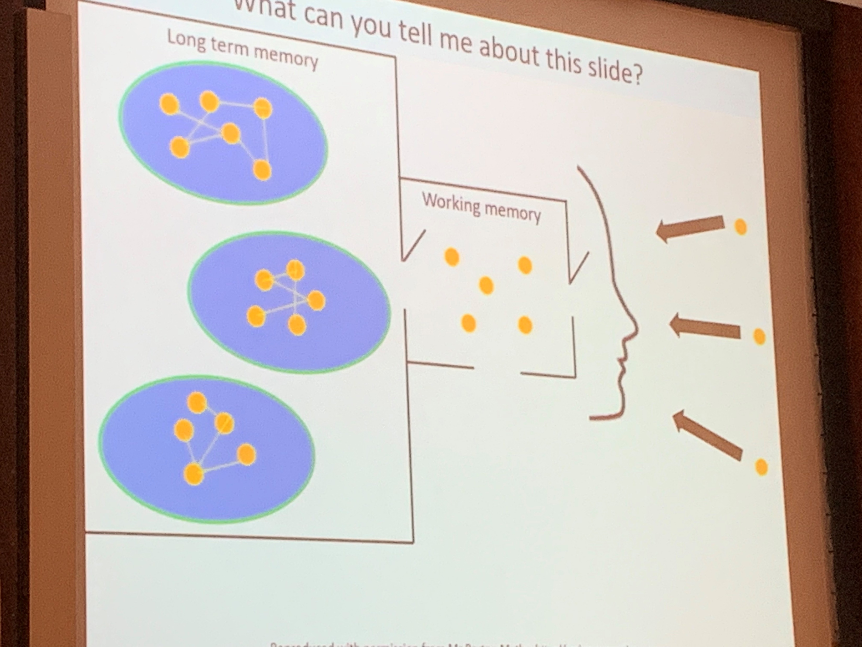
Say what you see

Slide 8
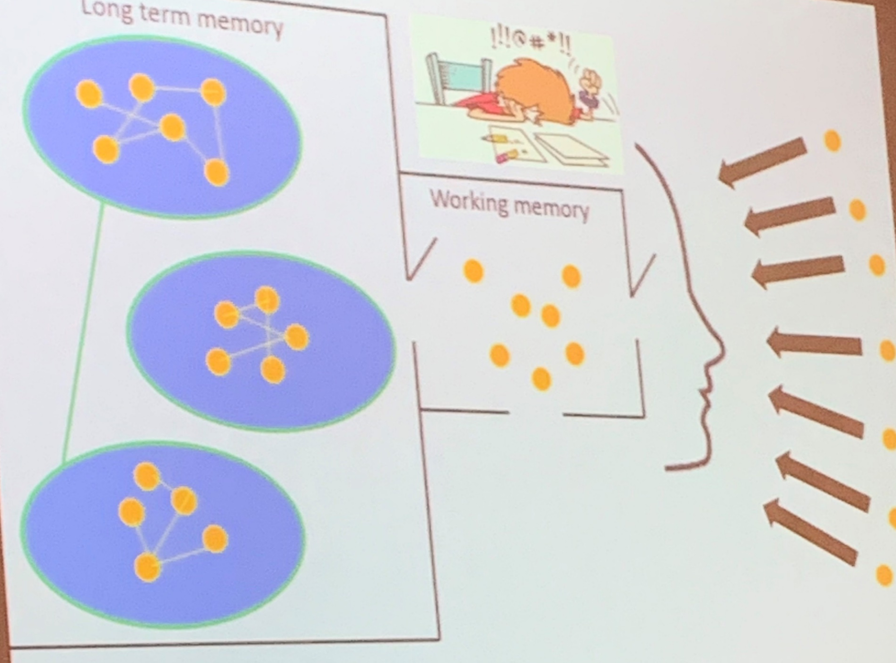
Say what you see

Slide 9
Cognitive Load Theory (CLT)
What is happening in the Working Memory? Three types of load…
Intrinsic
complexity of concepts
Extraneous
complexity of the instructional materials
Germane
building the mental models (schema) about the concepts
external influences
inter-relatedness of ideas
Notes:
https://impact.chartered.college/article/shibli-cognitive-load-theory-classroom/

Slide 10
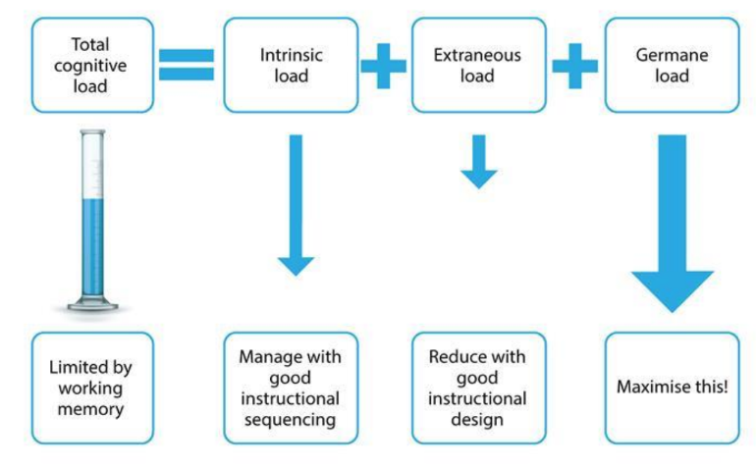
Cognitive Load Theory (CLT)
Greer, D.L., et al, Cognitive theory of multimedia learning…, Journal of Education, 2013, 193(2), 41-50
https://www.researchgate.net/publication/269112838
Notes:
https://eic.rsc.org/feature/improving-practical-work-with-integrated-instructions/3009798.article

Slide 11
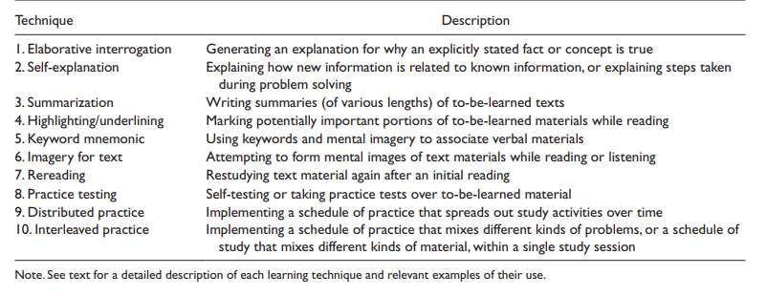
Exemplar metacognitive strategies which can reduce cognitive load
Donker, A. S., de Boer, H., Kostons, D., Dignath van Ewijk, C. C., & van der Werf, M. P. C. (2014) Effectiveness of learning strategy instruction on academic performance: A meta-analysis. Educational Research Review, 11, 1–26. https://doi.org/10.1016/j.edurev.2013.11.002. (Table taken from p6)

Slide 12
How do you develop germane load?
Consider learners prior knowledge!
Novice students
Teachers model rationale for each step
Teacher explain how topics build and link to each other starter last lesson last topic last year
Expert students
Students self explain rationale
for each step
Students build own concept maps
that link topics together
Gradually remove support

Slide 13
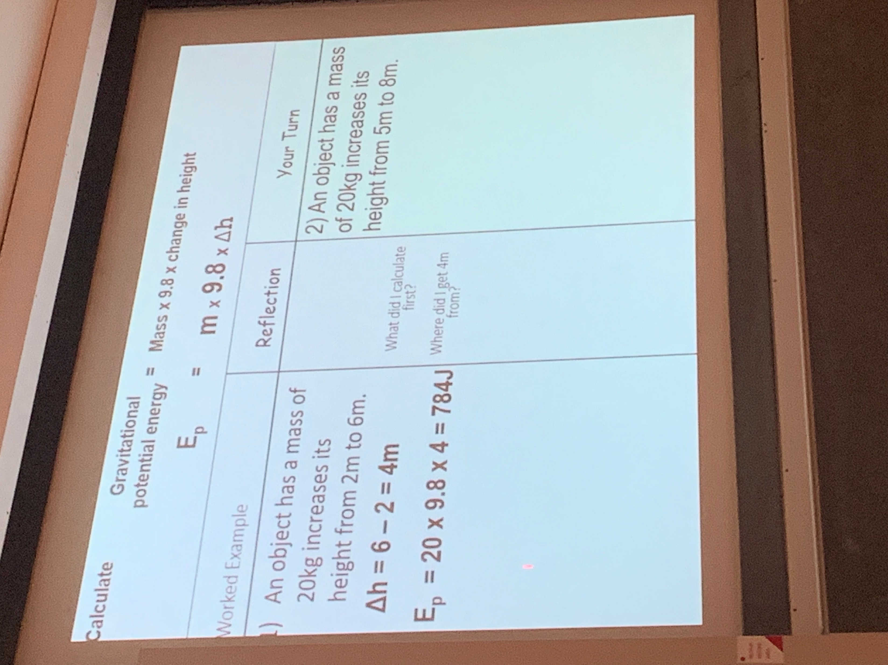
Showing the rationale (Sweller et all 1988)

Slide 14
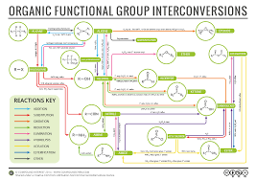
Modelling concept maps

Slide 15
How do you reduce extraneous load
technique | Description | Impact
Worked example | Replaces conventional problems and crutches with worked examples. | Reduces extraneous load by exemplifying key steps to problems.
Completion effect (faded examples) | Replace conventional problems with worked examples where certain steps are missing | Reduces extraneous load by gradually giving different parts of the problem allowing time to embed each step
Split attention effect
Modality effect | Remove excess text from slides use visual cues with narration to explain concepts | Reduces extraneous load as the multimodal presentation visual and auditory processors
Goal free effect | Replace conventional problems with goal free problems which provide students with non specific goal | Reduces extraneous load caused by relating a problem to a specific goal
Redundancy effect | Replace multiple sources of information and distractors | Reduces extraneous load caused by unnecessarily processing redundant information

Slide 16
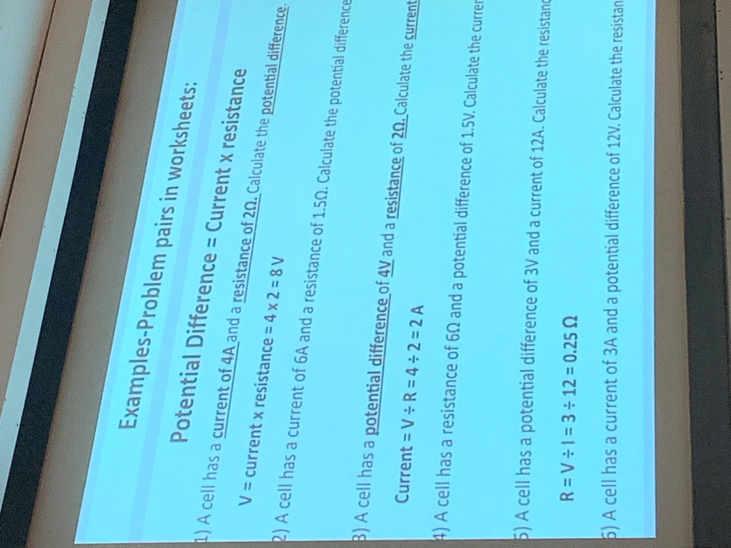
Worked examples problem pairs

Slide 17
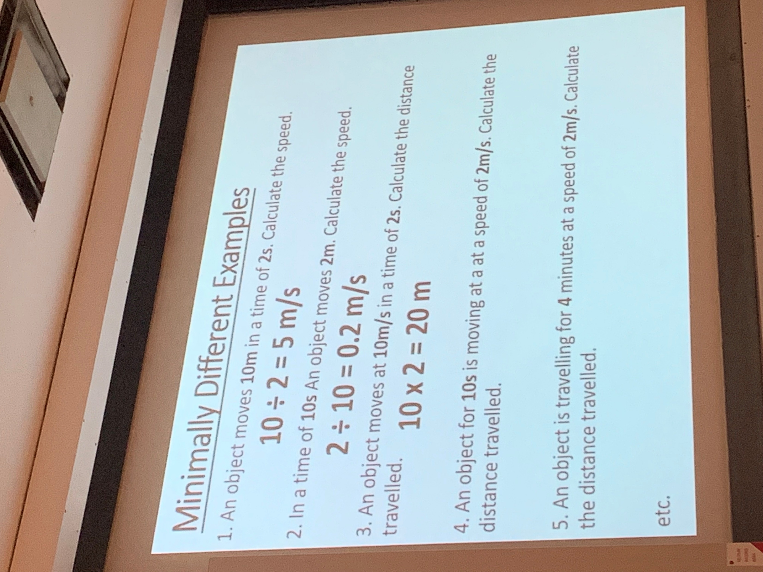
Minimally different worked examples

Slide 18
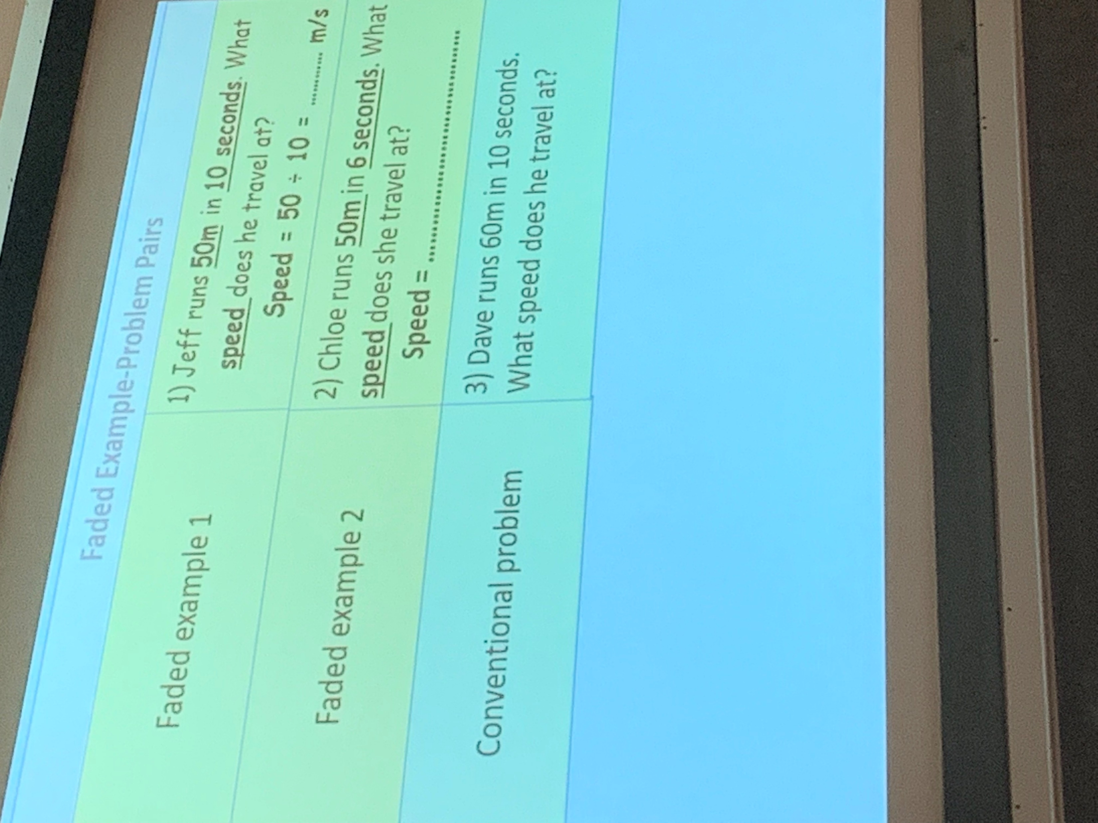
Faded examples

Slide 19
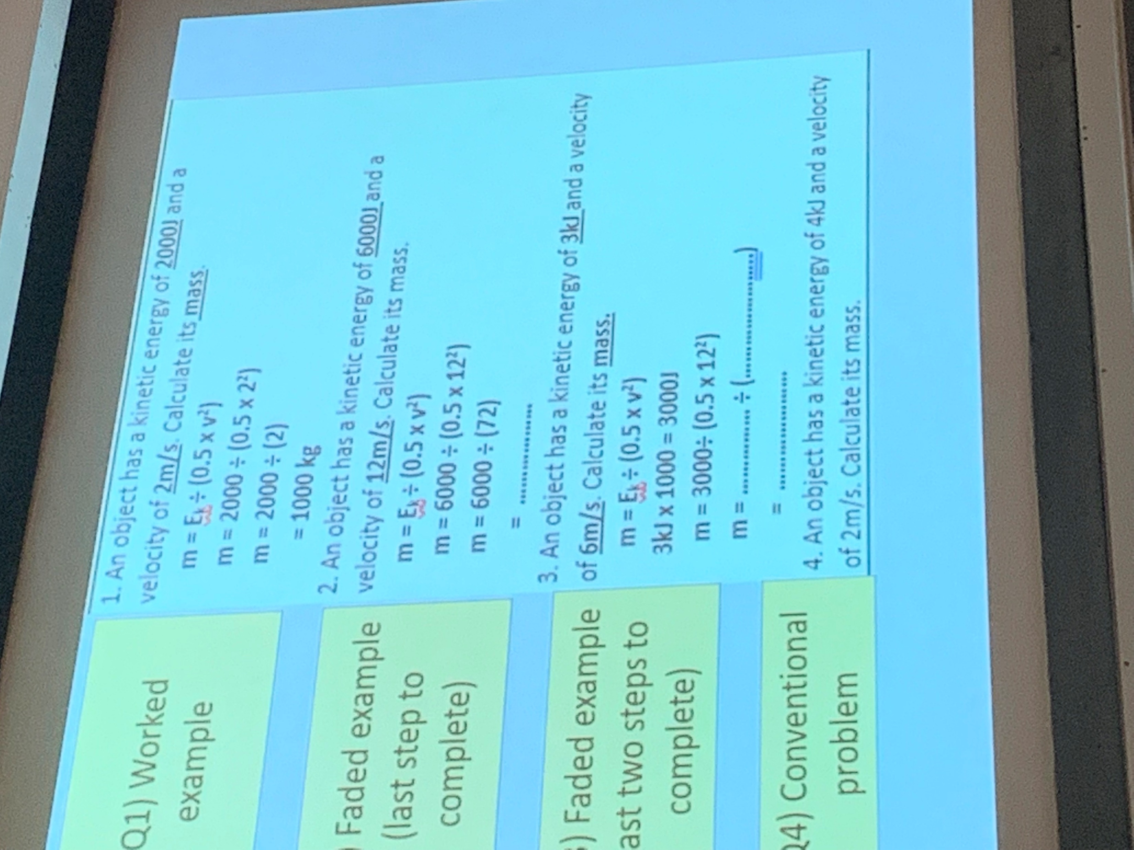

Slide 20
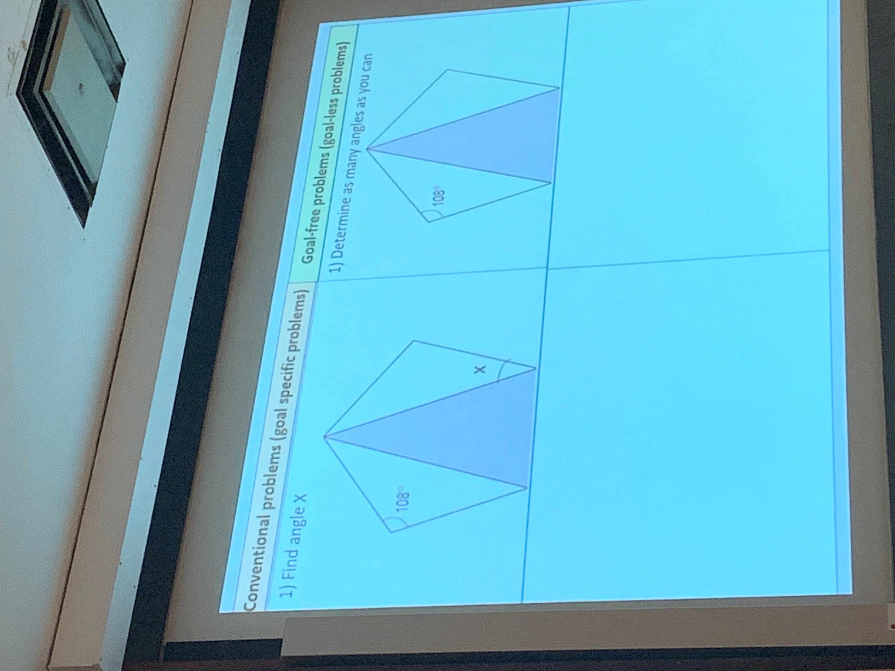
Goal free effect

Slide 21
Reducing instrinsic load Long term Memory: A science schema
Heat 100 cm³ of water to 50°C
xxxxxxxxxxxxxxxxxxxxx
xxxxxxxxxxxxxxxxxxxxx

Slide 22
Example: Titration
An intrinsically complex activity
New equipment
Recalling prior knowledge
Making and understanding observations
Accurate measurement
Calculation

Slide 23
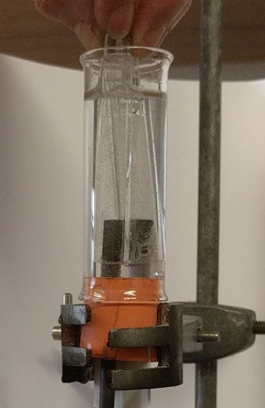
Extraneous load - electrolysis
Collecting enough gas
Spillages in setting up the test tubes
Getting the test tubes filled
Connecting power pack and getting it working
Getting the boss and clamp right

Slide 24
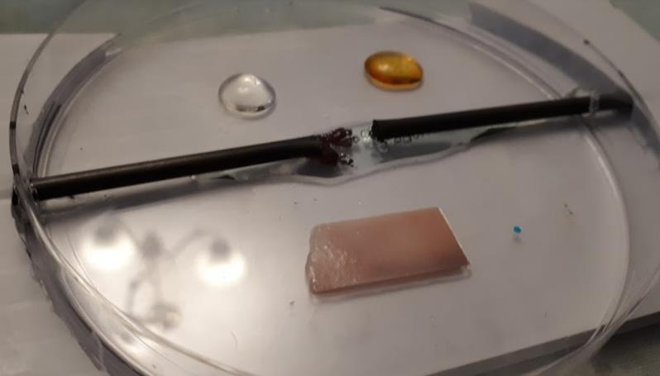
Simplifying equipment
Notes:
The microscale version of electrolysis.

Slide 25
Split attention – a demonstration
Time how long it take you to:
Write out all the numbers from 1 to 26 in order, left to right.
---THEN---
Write out all the letters from A to Z in order, left to right.
Make a note of how long that took.

Slide 26
Split attention – a demonstration
Without looking at your previous work…
Time how long it takes you to:
Write out A1, B2, C3 through to Z26, in order, left to right.
Compare with your previous time.

Slide 27


A model of memory
central executive
Working memory ‘Fluid systems’
visuospatial
sketchpad
episodic buffer
phonological loop
Long term memory ‘Crystallised systems’
semantics (general knowledge)
episodic (events)
procedural (how to)
Baddeley. A., The episodic buffer: a new component of working memory?, Trends in Cognitive Science, 2000, 4(11), 417-23 - http://www.sciencedirect.com/science/article/pii/S1364661300015382

Slide 28
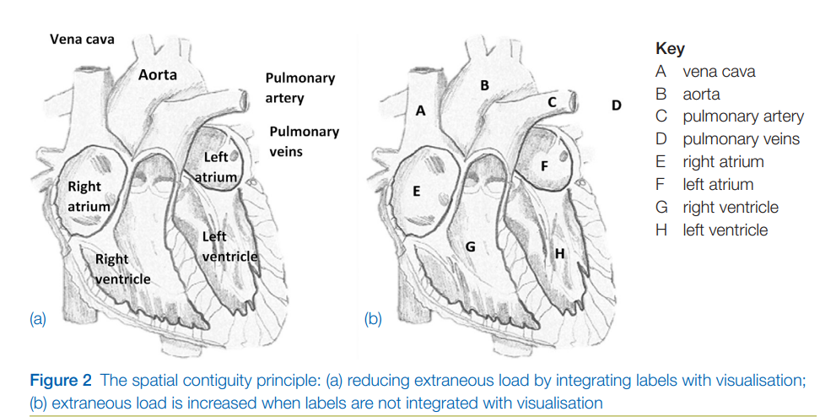
Extraneous load – the split-attention effect
Rebecca Torrance Jenkins, Using educational neuroscience and psychology to teach science Part 1. SSR December 2017

Slide 29
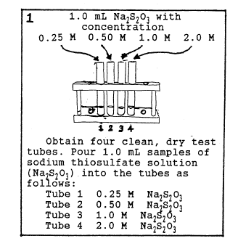
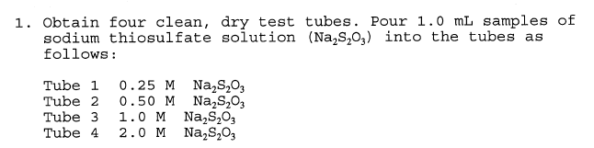
Integrated Instructions – Deschri et al
Deschri et al (1997), J Res Sci Teach, 34(9), 891-904: Effect of a Laboratory Manual Design Incorporating Visual
Information-Processing Aids on Student Learning and Attitudes

Slide 30
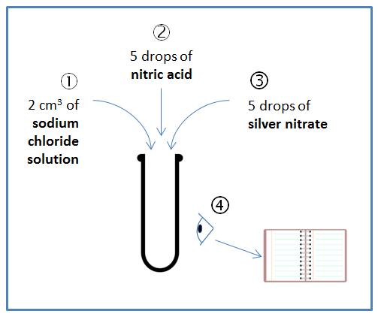
Integrated Instructions
Add 2 cm³ of 0.2 M sodium chloride solution to a test tube.
Add 5 drops of 0.5 M nitric acid to the same test tube.
Add 5 drops of 0.1 M silver nitrate solution to the same test tube.
Make and record your observations.

Slide 31
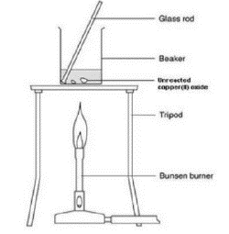
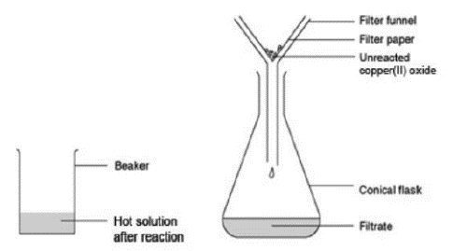
Split attention in practical work
a Add 20 cm3 of the 0.5 M sulfuric acid to the 100 cm3 beaker. Heat carefully on the tripod with a gentle blue flame until nearly boiling.
b When the acid is hot enough (just before it starts to boil), use a spatula to add small portions of
copper(II) oxide to the beaker. Stir the mixture gently for up to half a minute after each addition.
c When all the copper(II) oxide has been added, continue to heat gently for 1 to 2 minutes to ensure reaction is complete. Then turn out the Bunsen burner. It may be wise to check (using pH or litmus paper) that no acid remains. If the acid has not been hot enough, excess acid can co-exist with copper oxide.
d Allow the beaker to cool slightly while you set up Stage 2.
Stage 2
e Place the filter funnel in the neck of the conical flask.
f Fold the filter paper to fit the filter funnel, and put it in the funnel.
g Make sure the beaker is cool enough to hold at the top. The contents should still be hot.
h Gently swirl the contents to mix, and then pour into the filter paper in the funnel. Allow to filter through.
i A clear blue solution should collect in the flask. If the solution is not clear, and black powder remains in it, you will need to repeat the filtration.
Stage 3 (optional)
j Rinse the beaker, and pour the clear blue solution back into it. Label the beaker with your name(s). Leave the beaker in a warm place, where it won't be disturbed, for a week or so. This will enable most of the water to evaporate. would fill with toxic fumes.
k Before all the water has evaporated, you should find some crystals forming on the bottom of the
beaker. Filter the solution. Collect the crystals from the filter paper onto a paper towel.
http://www.rsc.org/learn-chemistry/resource/res00001917/reacting-copper-ii-oxide-with-sulfuric-acid?cmpid=CMP00006703
Cook, M.P., 2006. Visual representations in science education: The influence of prior knowledge and cognitive load theory on instructional design principles. Science education, 90(6), pp.1073-1091.

Slide 32
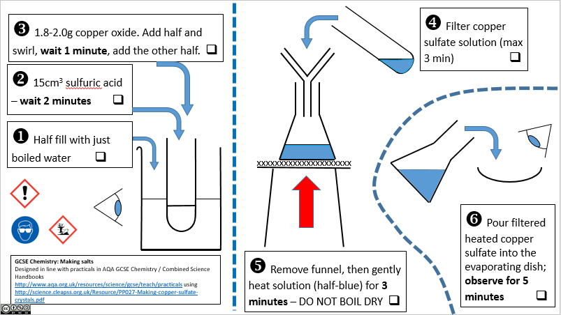
Integrated-instructions in practical work

Slide 33
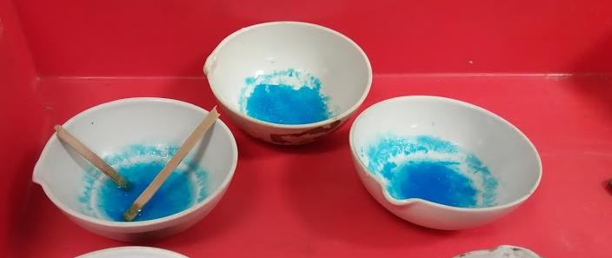
Student practical work

Slide 34

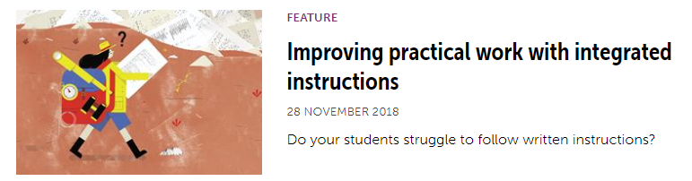
Making integrated instructions
https://eic.rsc.org/feature/improving-practical-work-with-integrated-instructions/3009798.article

Slide 35
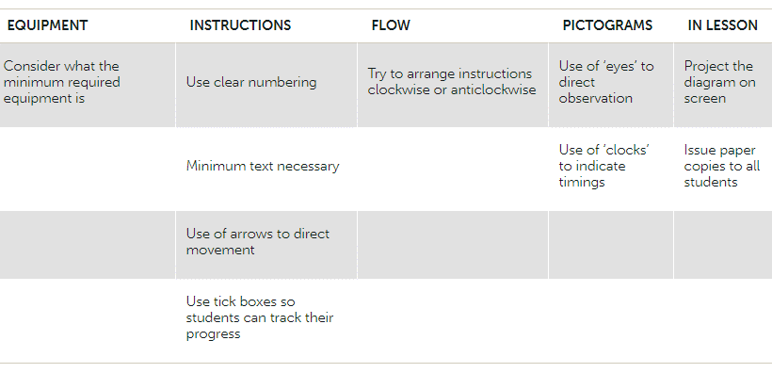

Slide 36
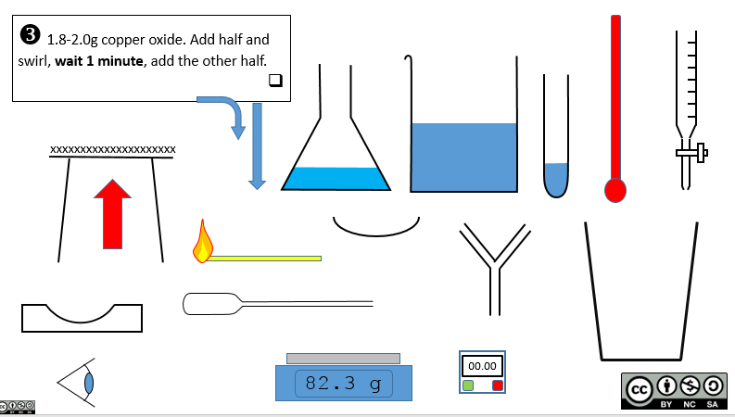

Making integrated instructions
chemix.org is also proving popular.
https://dave2004b.wordpress.com/2018/02/25/integrated-instructions-templates/

Slide 37
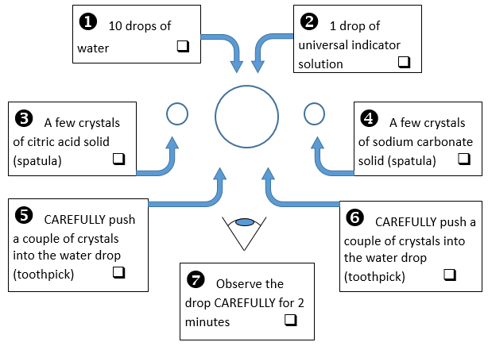
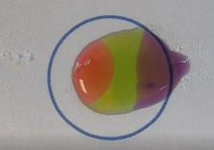
Microscale neutralisation
Questions:
Describe the sequence of observations – what happened first, second etc.
What observations did you make that solutions were formed?
What observations did you make that showed a neutralisation has occurred?
https://www.youtube.com/watch?v=qDeqKkSK3xI&t

Slide 38
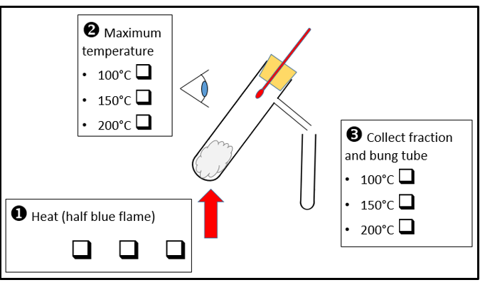
Distillation of crude oil
Questions:
Describe the change in temperature you observed as you heated the crude oil.
What observations did you make that showed distillation was occurring?
What was the purpose of the tube between the boiling tube and the collection test tube?

Slide 39
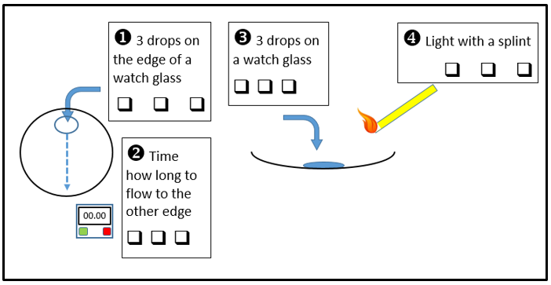
Properties of crude oil fractions
Questions:
Describe how the viscosity changed between the fractions.
Describe how the ease of setting light to the fractions changed between the fractions.
Describe how the odour changed between the fractions.

Slide 40

Journal of Chemical Education article

Slide 41
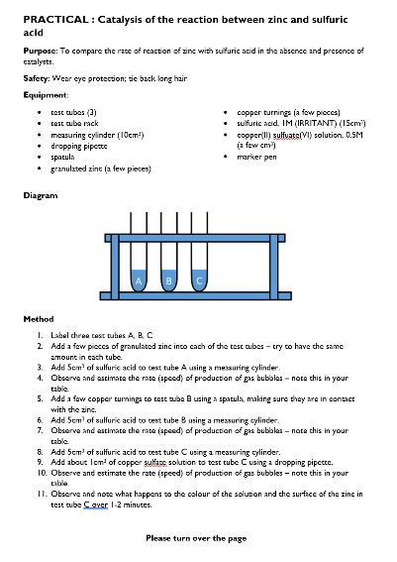
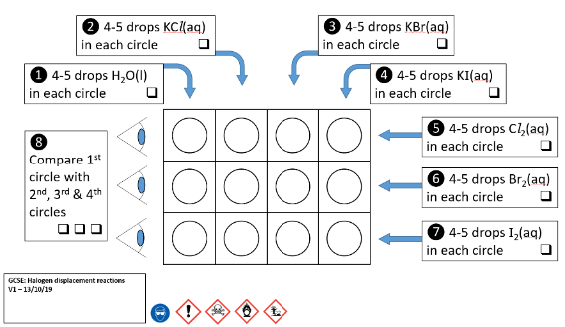
Year 9: Traditional vs Integrated

Slide 42
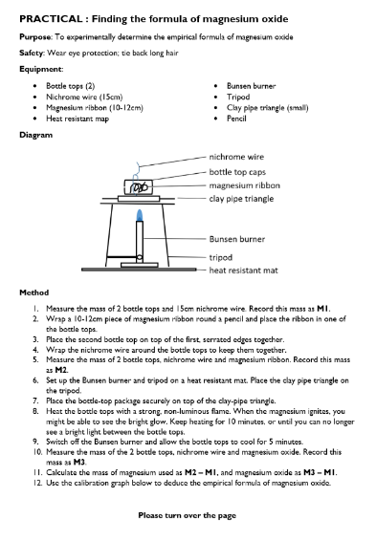
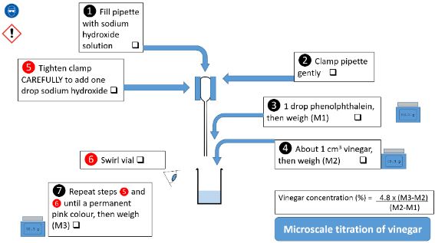
Year 12: Traditional vs Integrated

Slide 43
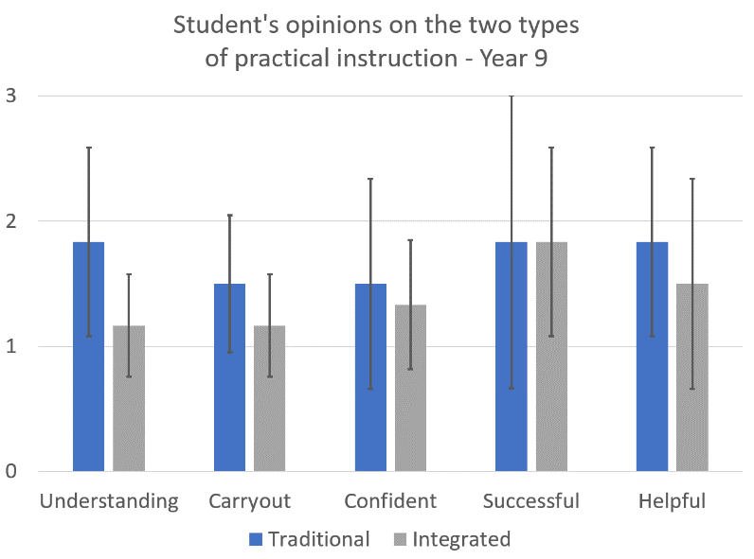
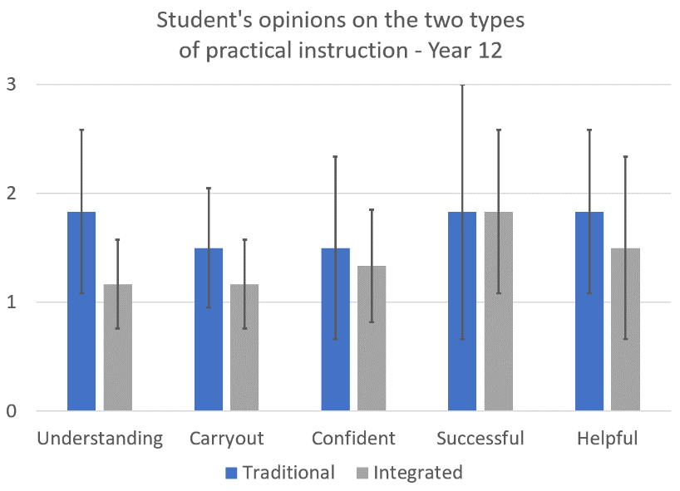
Student opinions of different practical types
lower is better
Understanding – How easy/hard did you find it to understand the practical instructions?
Carryout – How easy/hard did you find it to carry out the practical work?
Confident – How confident did you feel during the practical work?
Successful – How successful did you feel at the end of the practical?
Helpful – How helpful was the practical in your learning?

Slide 44
References
Clark, R., Nguyen, F. & Sweller, J. (2006) Efficiency in Learning: Evidence-Based Guidelines to Manage Cognitive Load. John Wiley & Sons.
Cook, M.P., 2006. Visual representations in science education: The influence of prior knowledge and cognitive load theory on instructional design principles. Science education, 90(6), pp.1073-1091.
Donker, A. S., de Boer, H., Kostons, D., Dignath van Ewijk, C. C., & van der Werf, M. P. C. (2014) Effectiveness of learning strategy instruction on academic performance: A meta-analysis. Educational Research Review, 11, 1–26. https://doi.org/10.1016/j.edurev.2013.11.002.
Paterson, D.J., 2019. Design and evaluation of integrated instructions in secondary-level chemistry practical work. Journal of Chemical Education, 96(11), pp.2510-2517. (Not available for full text view)
Rosenshine, B. (2012) Principles of Instruction: Research-based strategies that all teachers should know. American Educator, 12–20
Sweller, J., (1988). Cognitive load during problem solving: Effects on learning. Cognitive science, 12(2), pp.257-285.
Sweller, J., Van Merrienboer, J.J. and Paas, F.G., 1998. Cognitive architecture and instructional design. Educational psychology review, 10(3), pp.251-296.

